Slide 1
Global Energy Balance

Slide 2
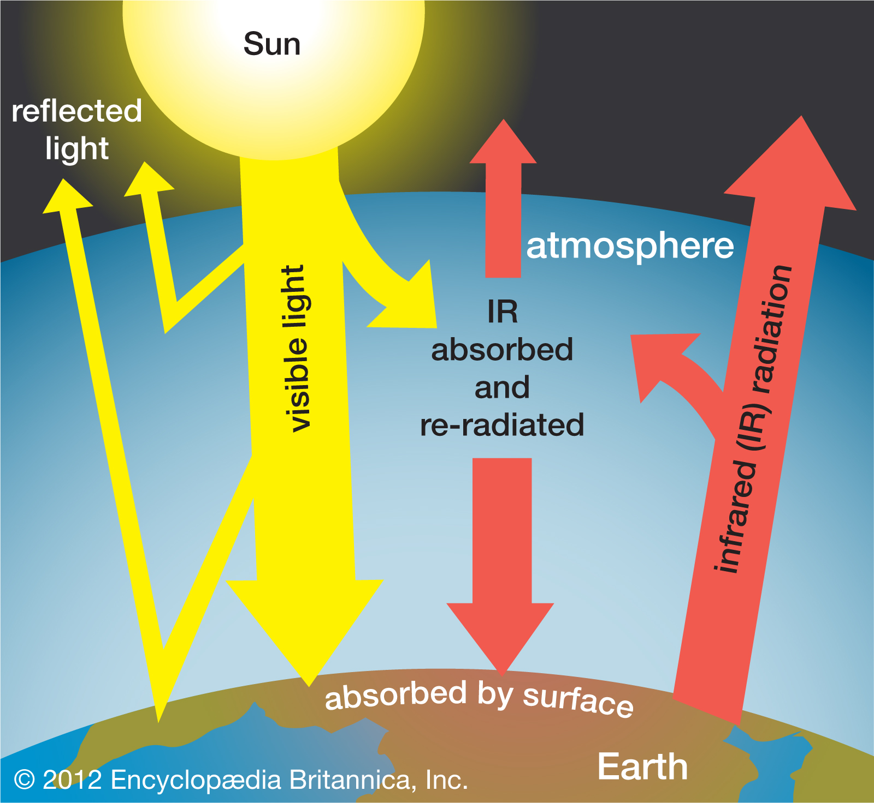
Our Source of Energy
Radiation from the Sun is the primary source of energy to the Earth, with the distribution of energy between the surface and the atmosphere being a main driver for weather processes.
31% is reflected back to space by the surface and atmosphere. This is referred to as albedo, or reflectance.
24% is absorbed by the atmosphere.
3% by the ozone in the stratosphere.
3% by clouds in the troposphere.
18% by atmospheric aerosols (gas and dust) in the troposphere.
45% is absorbed by the surface.
25% by direct solar radiation.
20% by diffuse radiation (sunlight scattered by the atmosphere).

Slide 3
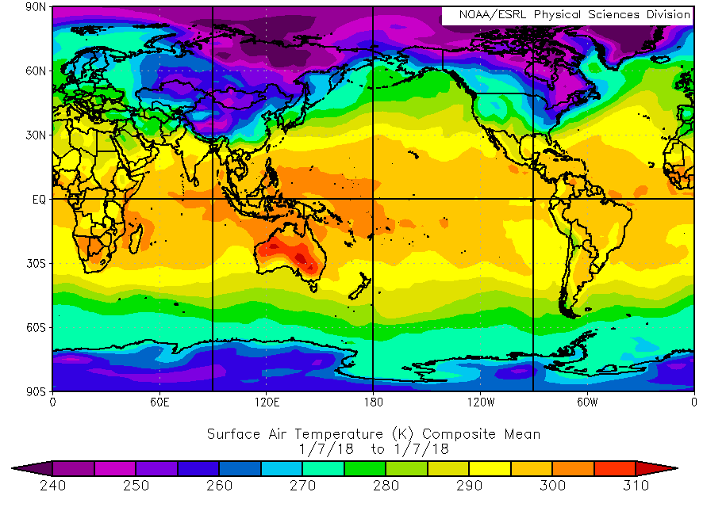
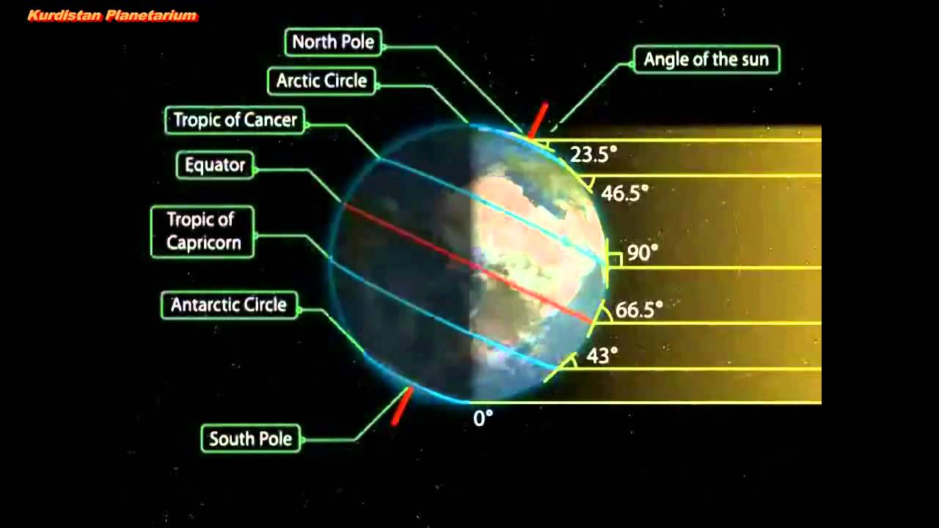
Earth’s Movement
Due to the rotation and tilt of the Earth, the actual amount of solar radiation reaching any point on the Earth depends on the season and the time of day.
The percentages may stay roughly the same, but the total amount of energy will change.
The Tropics receive the most sunlight while the Arctic receives the least, leading to a global temperature gradient.

Slide 4
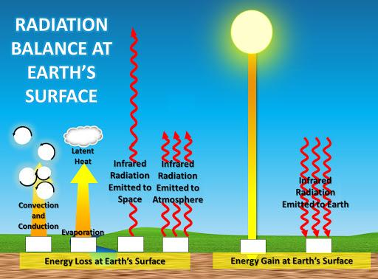
Surface Processes
Since the surface receives more solar energy than the atmosphere, other processes must work to remove the excess surface energy.
Conduction, convection, and infrared radiation are the primary surface cooling processes.
These processes drive atmospheric motion by changing temperature, pressure, and moisture gradients over space and time.

Slide 5
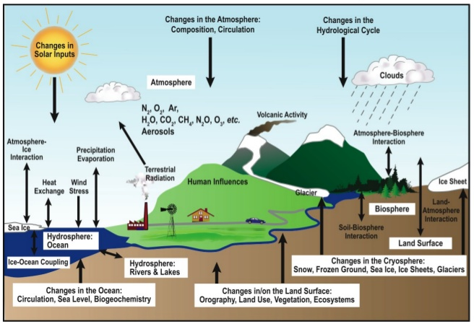
Surface Variation
These are all averages, and variations in surface and atmospheric properties can lead to substantial variations in these values.
Vegetation, topography, soil type, and water bodies play a role in surface energy variability.
Cloudiness, greenhouse gas concentration (carbon dioxide, methane, water vapor, etc.), and pollution play a role in atmospheric variability.

Slide 6
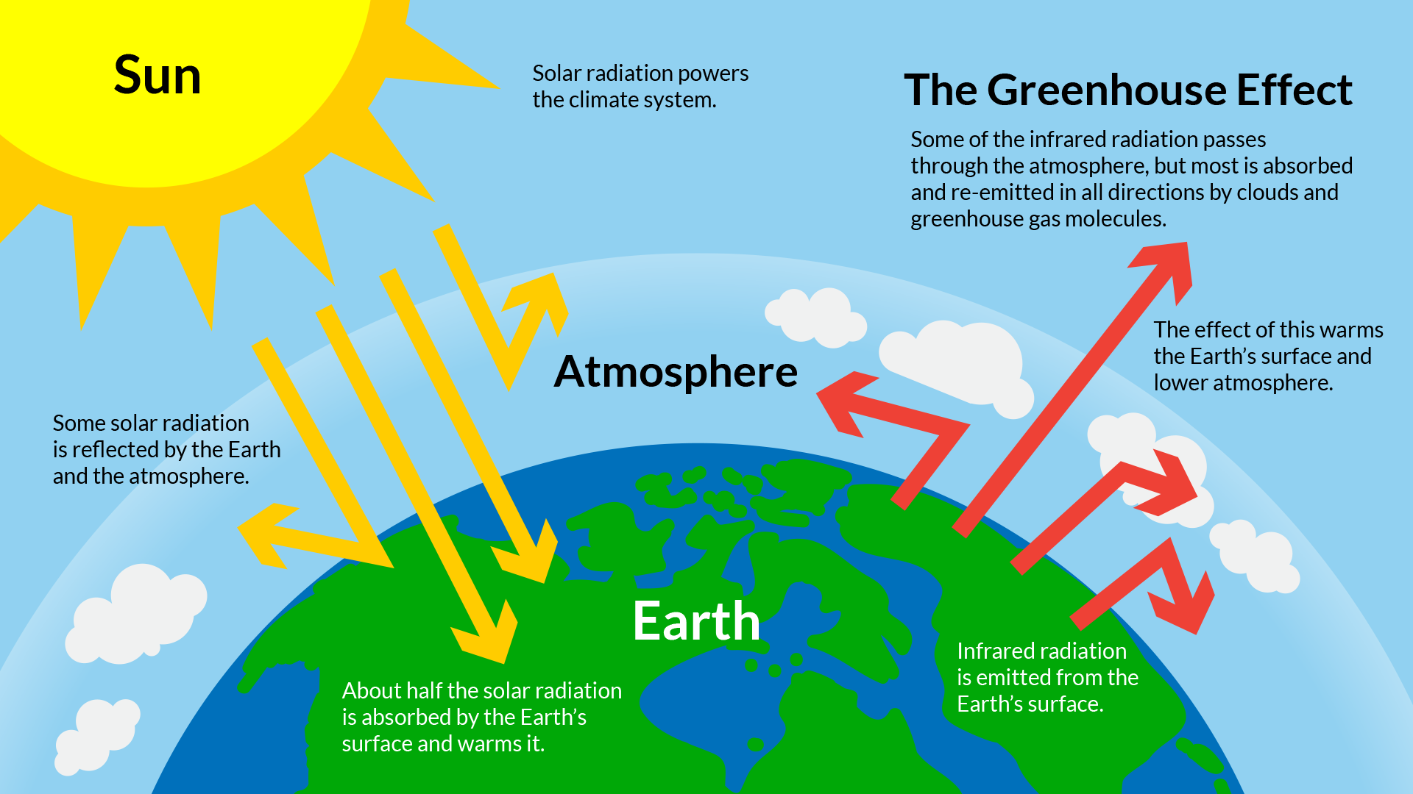
Greenhouse Effect
While sunlight generally goes straight through the atmosphere, infrared radiation emitted by the Earth (as part of its cooling process) is easily absorbed and reemitted by gases in the atmosphere.
This is called the Greenhouse Effect and is a critical process for keeping temperatures from dropping too low or too quickly when the sun goes down.

